Slide 1
Performance Tuning
Adjusting various parameters and design choices to improve system performance for a specific application.
Tuning is best done by
  identifying bottlenecks, and
  eliminating them.

Slide 2
Bottlenecks
Performance of most systems (at least before they are tuned) usually limited by performance of one or a few components: these are called bottlenecks
  E.g. 80% of the code may take up 20% of time and 20% of code takes up 80% of time
    Worth spending most time on 20% of code that take 80% of time
Bottlenecks may be in hardware (e.g. disks are very busy, CPU is idle), or in software
Removing one bottleneck often exposes another
De-bottlenecking consists of repeatedly finding bottlenecks, and removing them
  This is a heuristic

Slide 3
Identifying Bottlenecks
Transactions request a sequence of services
  e.g. CPU, Disk I/O, locks
With concurrent transactions, transactions may have to wait for a requested service while other transactions are being served
Can model database as a queueing system with a queue for each service
  transactions repeatedly do the following
    request a service, wait in queue for the service, and get serviced
Bottlenecks in a database system typically show up as very high utilizations (and correspondingly, very long queues) of a particular service
  E.g. disk vs CPU utilization
  100% utilization leads to very long waiting time:
    Rule of thumb: design system for about 70% utilization at peak load
    utilization over 90% should be avoided

Slide 4
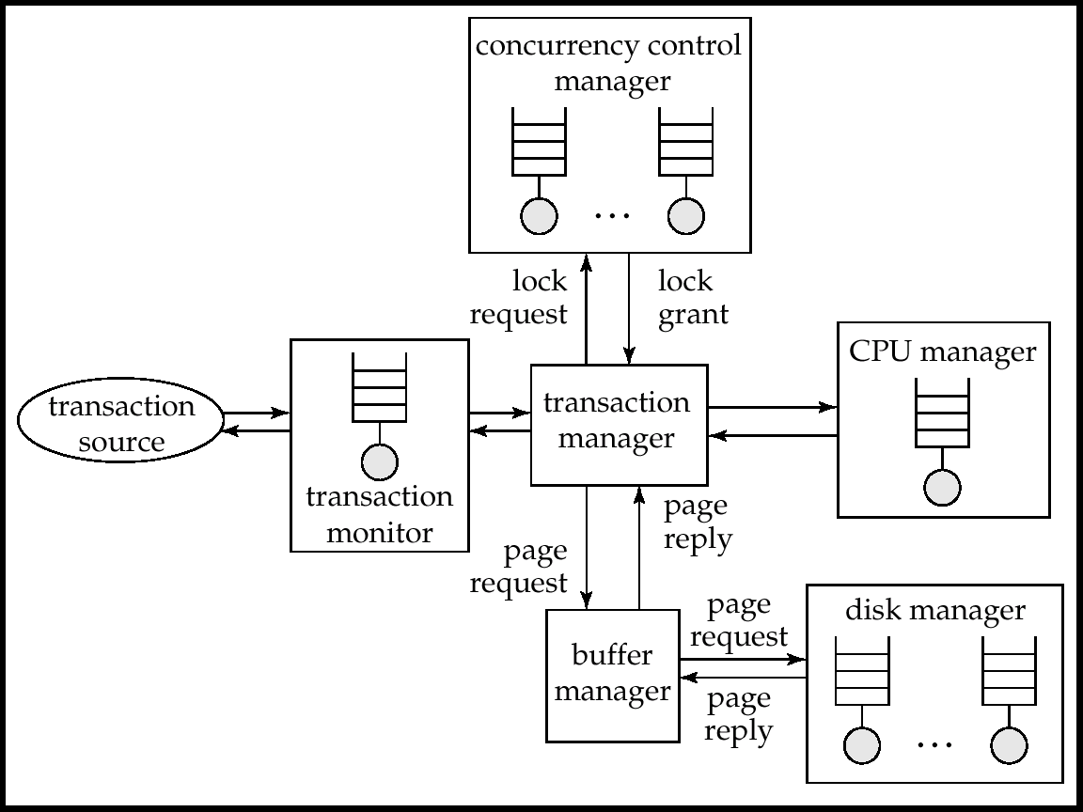
Queues In A Database System

Slide 5
Performance Tuning
Can tune a database system at 3 levels:
  Hardware(Lowest Level) -- e.g., add disks to speed up I/O, add memory to increase buffer hits, move to a faster processor.
  Database system parameters -- e.g., set buffer size to avoid paging of buffer, set checkpointing intervals to limit log size. System may have automatic tuning.
  Higher level database design, such as the schema, indices and transactions

Slide 6
Tunable Parameters
Tuning of hardware
Tuning of schema
Tuning of indices
Tuning of materialized views
Tuning of transactions

Slide 7
Tuning of Hardware
Even well-tuned transactions typically require a few I/O operations
  Typical disk supports about 100 random I/O operations per second
  Suppose each transaction requires just 2 random I/O operations. Then to support n transactions per second, we need to stripe data across n/50 disks (ignoring skew)
Number of I/O operations per transaction can be reduced by keeping more data in memory
  If all data is in memory, I/O needed only for writes
  Keeping frequently used data in memory reduces disk accesses, reducing number of disks required, but has a memory cost

Slide 8
Hardware Tuning: Five-Minute Rule
Question: which data to keep in memory:
  If a page is accessed n times per second, keeping it in memory saves
    n * price-per-disk-drive
    accesses-per-second-per-disk
  Cost of keeping page in memory
    price-per-MB-of-memory
    pages-per-MB-of-memory
  Break-even point: value of n for which above costs are equal
    If accesses are more then saving is greater than cost
  Solving above equation with current disk and memory prices leads to:
  5-minute rule: if a page that is randomly accessed is used more frequently than once in 5 minutes it should be kept in memory
    (by buying sufficient memory!)

Slide 9
Hardware Tuning: One-Minute Rule
For sequentially accessed data, more pages can be read per second. Assuming sequential reads of 1MB of data at a time:
1-minute rule: sequentially accessed data that is accessed
once or more in a minute should be kept in memory
Prices of disk and memory have changed greatly over the years, but the ratios have not changed much
  so rules remain as 5 minute and 1 minute rules, not 1 hour or 1 second rules!

Slide 10
???
Hardware Tuning: Choice of RAID Level
To use RAID 1 or RAID 5?
  Depends on ratio of reads and writes
    RAID 5 requires 2 block reads and 2 block writes to write out one data block
If an application requires r reads and w writes per second
  RAID 1 requires r + 2w I/O operations per second
  RAID 5 requires: r + 4w I/O operations per second
For reasonably large r and w, this requires lots of disks to handle workload
  RAID 5 may require more disks than RAID 1 to handle load!
  Apparent saving of number of disks by RAID 5 (by using parity, as opposed to the mirroring done by RAID 1) may be illusory!
Thumb rule: RAID 5 is fine when writes are rare and data is very large, but RAID 1 is preferable otherwise
  If you need more disks to handle I/O load, just mirror them since disk capacities these days are enormous!
Notes:
RAID (originally redundant array of inexpensive disks, now commonly redundant array of independent disks) is a data storage virtualization technology that combines multiple physical disk drive components into a single logical unit for the purposes of data redundancy, performance improvement, or both

Slide 11
Tuning the Database Design
Vertical Partitions
Denormalized relations
Cluster together joins in same partitions
Index Tuning
Materialized views

Slide 12
Tuning the Database Design
Schema tuning
  Vertically partition relations to isolate the data that is accessed most often -- only fetch needed information.
    E.g., split account into two, (account-number, branch-name) and (account-number, balance).
      Branch-name need not be fetched unless required
  Improve performance by storing a denormalized relation
    E.g., store join of account and depositor; branch-name and balance information is repeated for each holder of an account, but join need not be computed repeatedly.
      Price paid: more space and more work for programmer to keep relation consistent on updates
    better to use materialized views
  Cluster together on the same disk page records that would
  match in a frequently required join,
    compute join very efficiently when required.

Slide 13
Tuning the Database Design (Cont.)
Index tuning
  Create appropriate indices to speed up slow queries/updates
  Speed up slow updates by removing excess indices
  Choose type of index (B-tree/hash) appropriate for most frequent types of queries.
  Choose which index to make clustered
Index tuning wizards look at past history of queries and updates (the workload) and recommend which indices would be best for the workload

Slide 14
Tuning the Database Design (Cont.)
Materialized Views(A materialized view is a database object that contains the results of a query.)
Materialized views can help speed up certain queries
  Particularly aggregate queries
Overheads
  Space
  Time for view maintenance
    Immediate view maintenance:done as part of update txn
      time overhead paid by update transaction
    Deferred view maintenance: done only when required
      update transaction is not affected, but system time is spent on view maintenance
        until updated, the view may be out-of-date
Preferable to denormalized schema since view maintenance
is systems responsibility, not programmers
  Avoids inconsistencies caused by errors in update programs

Slide 15
Tuning the Database Design (Cont.)
How to choose set of materialized views
  Helping one transaction type by introducing a materialized view may hurt others
  Choice of materialized views depends on costs
    Users often have no idea of actual cost of operations
  Overall, manual selection of materialized views is tedious
Some database systems provide tools to help DBA choose views to materialize
  “Materialized view selection wizards”

Slide 16
Tuning of Transactions
Basic approaches to tuning of transactions
  Improve set orientation
  Reduce lock contention
Rewriting of queries to improve performance was important in the past, but smart optimizers have made this less important
Communication overhead and query handling overheads significant part of cost of each call
  Combine multiple embedded SQL/ODBC/JDBC queries into a single set-oriented query
    Set orientation -> fewer calls to database
    E.g. tune program that computes total salary for each department using a separate SQL query by instead using a single query that computes total salaries for all department at once (using group by)
  Use stored procedures: avoids re-parsing and re-optimization
  of query

Slide 17
Tuning of Transactions (Cont.)
Reducing lock contention
Long transactions (typically read-only) that examine large parts of a relation result in lock contention with update transactions
  E.g. large query to compute bank statistics and regular bank transactions
To reduce contention
  Use multi-version concurrency control
    E.g. Oracle “snapshots” which support multi-version 2PL
  Use degree-two consistency (cursor-stability) for long transactions
    Drawback: result may be approximate

Slide 18
Tuning of Transactions (Cont.)
Long update transactions cause several problems
  Exhaust lock space
  Exhaust log space
    and also greatly increase recovery time after a crash, and may even exhaust log space during recovery if recovery algorithm is badly designed!
Use mini-batch transactions to limit number of updates that a single transaction can carry out. E.g., if a single large transaction updates every record of a very large relation, log may grow too big.
  * Split large transaction into batch of ``mini-transactions,'' each performing part of the updates
  Hold locks across transactions in a mini-batch to ensure serializability
    If lock table size is a problem can release locks, but at the cost of serializability
  * In case of failure during a mini-batch, must complete its
  remaining portion on recovery, to ensure atomicity.

